Slide 1
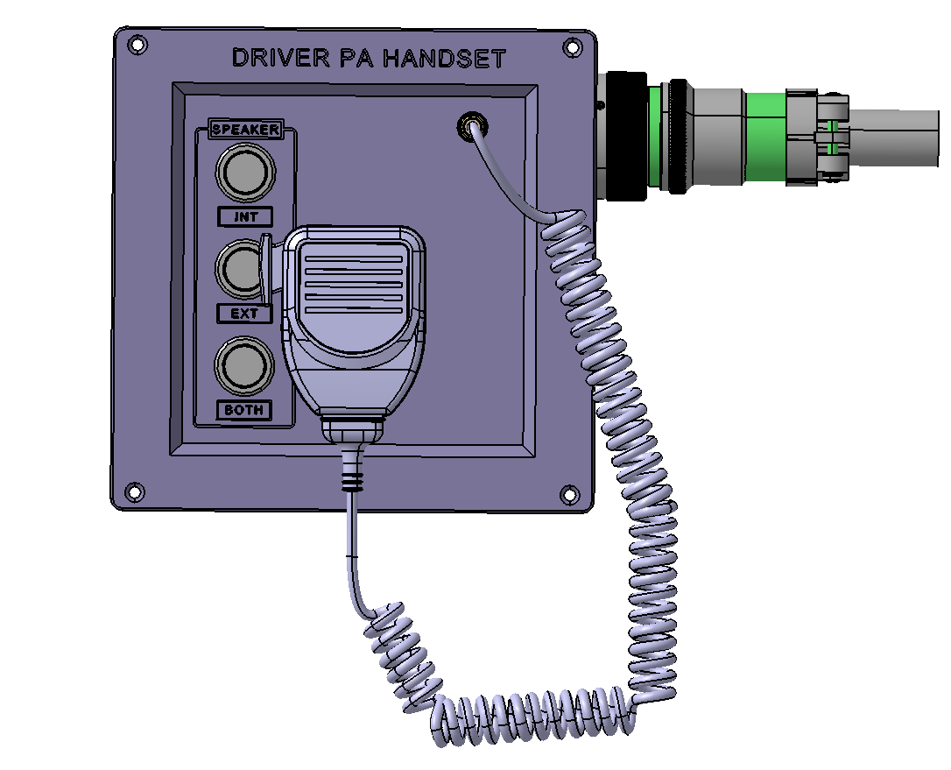
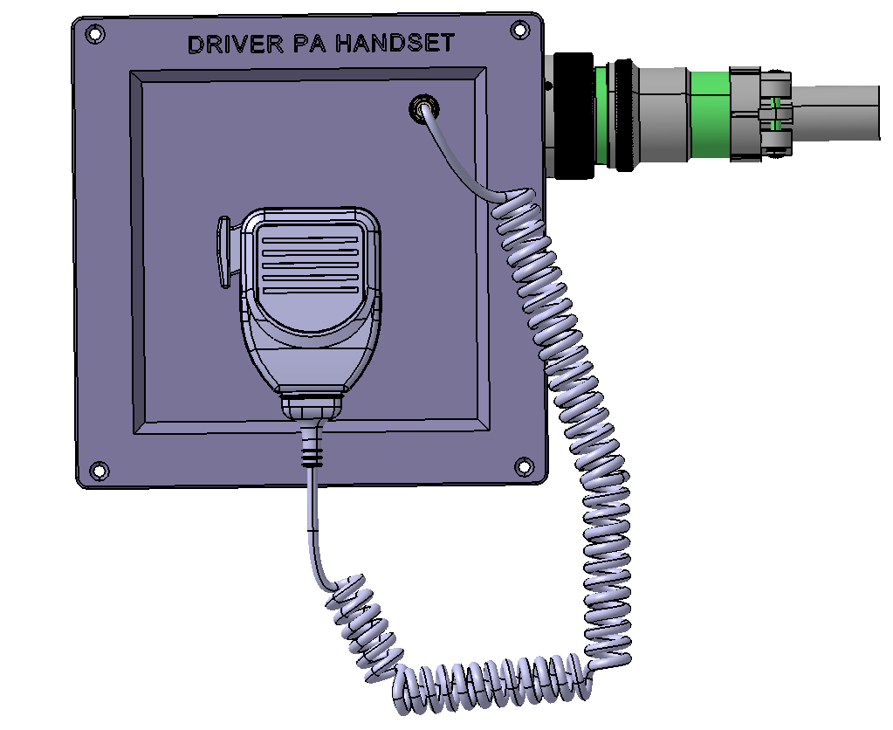

Slide 2
Diagram 4.2.1.2-A(24P)
Master PAC at HOC - Consist Configuration
Master PAC
Slave PAC
Slave PAC
Slave PAC
Slave PAC
Slave PAC
Key-On Switch
CRA
CRA
CRA
CRA
CRA
CRA
(Ra)
(Rb)
(Ra)
(Rb)
(Ra)
(Rb)
(Ra)
(Rb)
(Ra)
(Rb)
(Ra)
(Rb)
HOC Coupler
Car #1
Car #2
Car #3
TOC Coupler
Diagram 4.2.1.2-B(24P)
Master PAC Not at HOC - Consist Configuration
Slave PAC
Slave PAC
Master PAC
Slave PAC
Slave PAC
Slave PAC
Slave PAC
Slave PAC
Key-On Switch
CRA
CRA
CRA
CRA
CRA
CRA
CRA
CRA
(Ra)
(Rb)
(Ra)
(Rb)
(Ra)
(Rb)
(Ra)
(Rb)
(Ra)
(Rb)
(Ra)
(Rb)
(Ra)
(Rb)
(Ra)
(Rb)
HOC Coupler
Car #1
Car #2
Car #3
Car #4
TOC Coupler

Slide 3
Communication Rack-A
DC 12V
PSA
DC 37.5V
Wimx
PA System MA
SCB
LIC
LONWORKS for MDS
A
WLR
A
LAN
VTX
Digital Video Signal
LVDS
Digital Video Signal
CNCS
ATA
HDD
CAB ON
PAC
Door & F/R
ODMETER
DC 37.5V
DC 37.5V
485
Card
RS485
Passenger Emergency
Intercom
Passenger Emergency
Intercom
DC 12V
BACK PLAN BOARD
RS485
ANSM
PEI ADDRESS, CALL
ANSM
VOIP
PEI ADDRESS, CALL
PEI Audio & Signal
PEI ADDRESS, CALL
PEI Audio & Signal
PEI Audio & Signal
Dual - tone
Dual - tone
DPO ADDRESS, ACT
DPO ADDRESS, ACT
PA Audio & Signal
PA Audio & Signal
DC 37.5V
DC 12V
Driver PA
HandSet
DPH
Audio
Driver PA
Operation Box
DIMMER
Audio
Audio
IC Audio & Signal, PA Audio
Audio
Driver Microphone
IC Audio & Signal, PA Audio
CPO ADDRESS, ACT
IC Audio & Signal, PA Audio
CPO ADDRESS, ACT
PEI TL
CPO ADDRESS, ACT
IC TL
MUTE
DC 37.5V
Passenger
Emergency
Intercom
ISP
ISP
Passenger
Emergency
Intercom
DC 37.5V
PA Audio TL
TRF
TRF
Dual- tone TL
RS485 TL
TRF
ISP
TRF
ISP
TRF
ISP
TRF
ISP
TRF
ISP
TRF
ISP
AAB
Interior Speaker CH1
Interior Speaker CH1
Audio LINE
Interior Speaker CH2
Interior Speaker CH2
DC 37.5V
LEFT Side Exterior Speaker PA
TRF
ESP
TRF
ESP
TRF
ESP
TRF
ESP
RIGHT Side Exterior Speaker PA
RS485 TL
RS485 TL
Dual- tone TL
Dual- tone TL
PA Audio TL
PA Audio TL
IC TL
IC TL
PEI TL
PEI TL

Slide 4
Communication Rack-A
PA System MB
Wimx
DC 37.5V
PSA
DC 12V
SCB
A
LONWORKS for MDS
LIC
A
WLR
Digital Video Signal
VTX
LAN
Digital Video Signal
LVDS
CNCS
ATA
CAB ON
HDD
Door & F/R
PAC
DC 37.5V
DC 37.5V
ODMETER
Passenger Emergency
Intercom
Passenger Emergency
Intercom
RS485
485
Card
DC 12V
ANSM
PEI ADDRESS, CALL
ANSM
RS485
BACK PLAN BOARD
PEI ADDRESS, CALL
PEI Audio & Signal
PEI ADDRESS, CALL
VOIP
PEI Audio & Signal
PEI Audio & Signal
Dual - tone
Dual - tone
DPO ADDRESS, ACT
DPO ADDRESS, ACT
PA Audio & Signal
PA Audio & Signal
Driver PA
HandSet
DC 12V
DC 37.5V
Audio
Audio
DIMMER
Driver PA
Operation Box
Audio
DPH
IC Audio & Signal, PA Audio
Driver Microphone
Audio
IC Audio & Signal, PA Audio
CPO ADDRESS, ACT
IC Audio & Signal, PA Audio
CPO ADDRESS, ACT
CPO ADDRESS, ACT
PEI TL
DC 37.5V
Passenger
Emergency
Intercom
ISP
ISP
Passenger
Emergency
Intercom
DC 37.5V
MUTE
IC TL
TRF
TRF
PA Audio TL
Dual- tone TL
ISP
ISP
ISP
ISP
ISP
ISP
RS485 TL
TRF
TRF
TRF
TRF
TRF
TRF
Interior Speaker CH1
Interior Speaker CH1
AAB
Interior Speaker CH2
Interior Speaker CH2
Audio LINE
LEFT Side Exterior Speaker PA
DC 37.5V
ESP
ESP
TRF
ESP
ESP
TRF
TRF
TRF
RIGHT Side Exterior Speaker PA
RS485 TL
RS485 TL
Dual- tone TL
Dual- tone TL
PA Audio TL
PA Audio TL
IC TL
IC TL
PEI TL
PEI TL

Slide 5
Communication Rack-A
DC 12V
PSA
DC 37.5V
Wimx
PA System MA
SCB
LONWORKS for MDS
CMU
2012년 04월 04 수정.
LIC
WLR
A
A
LAN
VTX
Digital Video Signal
※ Not included in scope of supply.
LVDS
Digital Video Signal
CNCS
ATA
HDD
CAB ON
PAC
Door & F/R
ODMETER
485
Card
RS485
DC 12V
BACK PLAN BOARD
RS485
ANSM
ANSM
VOIP
DPH ADDRESS.
PEI ADDRESS.
PEI Audio.
PEI Audio.
Dual - tone
Dual – tone.
DPO ADDRESS
DPO ADDRESS.
PA Audio
PA Audio.
DC 37.5V
Driver PA
Operation Box
POWER DC 24V
DPH
OCC AUDIO
DIMMER
Driver Microphone
CAB / UNCOUPLE REDUNDANCY Signal
Audio
CAB / UNCOUPLE REDUNDANCY signal
CAB / UNCOUPLE REDUNDANCY signal
PEI ADDRESS.
CPO ADDRESS, ACT
CPO ADDRESS.
PEI TL
MUTE
PA Control TL
DC 37.5V
Passenger
Emergency
Intercom
ISP
ISP
Passenger
Emergency
Intercom
DC 37.5V
PA Audio TL
TRF
TRF
Dual- tone TL
RS485 TL
TRF
ISP
TRF
ISP
TRF
ISP
TRF
ISP
TRF
ISP
TRF
ISP
AAB
Interior Speaker CH1
Interior Speaker CH1
Audio LINE
Interior Speaker CH2
Interior Speaker CH2
DC 37.5V
LEFT Side Exterior Speaker PA
TRF
ESP
TRF
ESP
TRF
ESP
TRF
ESP
RIGHT Side Exterior Speaker PA
RS485 TL
RS485 TL
Dual- tone TL
Dual- tone TL
PA Audio TL
PA Audio TL
PA Control TL
PA Control TL
PEI TL
PEI TL

Slide 6
Communication Rack-A
DC 12V
PSA
DC 37.5V
Wimx
PA System MB
SCB
LONWORKS for MDS
CMU
2012년 04월 04 수정.
LIC
WLR
A
A
LAN
VTX
Digital Video Signal
※ Not included in scope of supply.
LVDS
Digital Video Signal
CNCS
ATA
HDD
CAB ON
PAC
Door & F/R
ODMETER
485
Card
RS485
DC 12V
BACK PLAN BOARD
RS485
ANSM
ANSM
VOIP
DPH ADDRESS.
PEI ADDRESS.
PEI Audio.
PEI Audio.
Dual - tone
Dual – tone.
DPO ADDRESS
DPO ADDRESS.
PA Audio
PA Audio.
DC 37.5V
Driver PA
Operation Box
POWER DC 24V
DPH
OCC AUDIO
DIMMER
Driver Microphone
CAB / UNCOUPLE REDUNDANCY signal
Audio
CAB / UNCOUPLE REDUNDANCY signal
CAB / UNCOUPLE REDUNDANCY signal
PEI ADDRESS.
CPO ADDRESS, ACT
CPO ADDRESS.
PEI TL
MUTE
PA Control TL
DC 37.5V
Passenger
Emergency
Intercom
ISP
ISP
Passenger
Emergency
Intercom
DC 37.5V
PA Audio TL
TRF
TRF
Dual- tone TL
RS485 TL
TRF
ISP
TRF
ISP
TRF
ISP
TRF
ISP
TRF
ISP
TRF
ISP
AAB
Interior Speaker CH1
Interior Speaker CH1
Audio LINE
Interior Speaker CH2
Interior Speaker CH2
DC 37.5V
LEFT Side Exterior Speaker PA
TRF
ESP
TRF
ESP
TRF
ESP
TRF
ESP
RIGHT Side Exterior Speaker PA
RS485 TL
RS485 TL
Dual- tone TL
Dual- tone TL
PA Audio TL
PA Audio TL
PA Control TL
PA Control TL
PEI TL
PEI TL

Slide 7

Communication Rack-A
Passenger Information System MA
PSA
DC 37.5V
Communication
Control Head
DC 37.5V
DC 12V
ADDRESS
SCB
CAB ON
AC 230V
AC 230V
AC 230V
LONWORKS for MDS
FDI
DC 37.5V
LIC
SDI
SDI
WLR
A
PII
LAN
VTX
Digital Video Signal
AC 230V
AC 230V
AC 230V
LVDS
Digital Video Signal
CNCS
ATA
HDD
CAB ON
PAC
Door & F/R
LCD Display
LCD Display
ODMETER
485
Card
RS485
DC 12V
BACK PLAN BOARD
RS485
VOIP
LCD Display
LCD Display
LCD Display
DC 37.5V
AC 230V
AC 230V
AC 230V
PII
PEI TL
SDI
SDI
IC TL
PA Audio TL
Dual- tone TL
AC 230V
AC 230V
RS485 TL
Audio LINE
AAB
DC 37.5V
RS485 TL
RS485 TL
Dual- tone TL
Dual- tone TL
PA Audio TL
PA Audio TL
IC TL
IC TL
PEI TL
PEI TL

Slide 8
Passenger Information System MB
Communication Rack-A
Communication
Control Head
DC 37.5V
DC 37.5V
PSA
ADDRESS
DC 12V
CAB ON
SCB
AC 230V
AC 230V
AC 230V
DC 37.5V
FDI
LONWORKS for MDS
SDI
SDI
LIC
PII
A
WLR
AC 230V
AC 230V
Digital Video Signal
VTX
LAN
Digital Video Signal
LVDS
CNCS
ATA
CAB ON
HDD
LCD Display
LCD Display
Door & F/R
PAC
ODMETER
RS485
485
Card
DC 12V
RS485
BACK PLAN BOARD
VOIP
DC 37.5V
LCD Display
LCD Display
LCD Display
PII
AC 230V
AC 230V
AC 230V
SDI
SDI
PEI TL
IC TL
PA Audio TL
AC 230V
AC 230V
Dual- tone TL
RS485 TL
AAB
Audio LINE
DC 37.5V
RS485 TL
RS485 TL
Dual- tone TL
Dual- tone TL
PA Audio TL
PA Audio TL
IC TL
IC TL
PEI TL
PEI TL

Slide 9
ESP
ESP
CSP
C P O
P E I
DPH
ANS
PA CONTROLLER
& POWER AMP
DPO
SP1
SP2
SP3
SP4
SP5
SP6
SP7
SP8
PA CONTROLLER
& POWER AMP
DPO
DPH
P E I
C P O
ANS
CSP
ESP
ESP
ESP
ESP
CSP
P E I
P E I
ANS
DPO
ESP
ESP
SP1
SP2
SP3
SP4
SP5
SP6
SP7
SP8
CSP
P E I
P E I
CONTROLLER
& POWER AMP
ANS
DPH
P E I
P E I
ANS
DPO
ESP
ESP
SP1
SP2
SP3
SP4
SP5
SP6
SP7
SP8
CONTROLLER
& POWER AMP
DPH
P E I
P E I
ANS
ESP
ESP

Slide 10
ESP
ESP
ESP
ESP
CSP
P E I
CSP
P E I
P E I
P E I
ANS
ANS
DPO
DPO
SP1
SP2
SP3
SP4
SP5
SP1
SP2
SP3
SP4
SP5
SP6
SP7
SP8
SP6
SP7
SP8
CONTROLLER
& POWER AMP
CONTROLLER
& POWER AMP
DPH
P E I
P E I
ANS
DPH
P E I
P E I
ANS
ESP
ESP
ESP
ESP

Slide 11
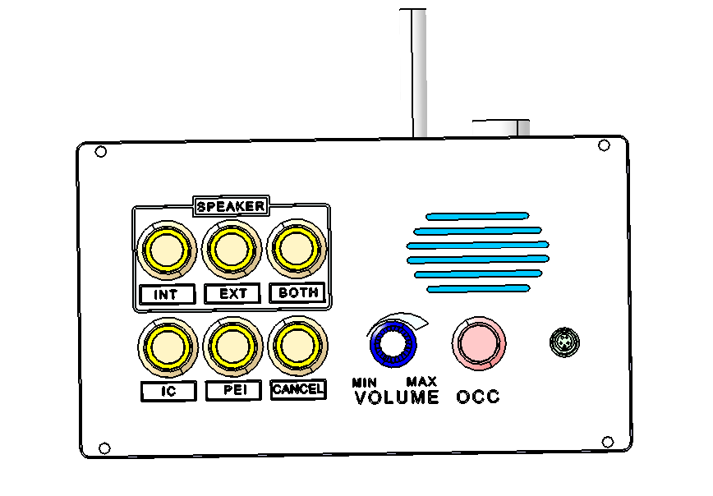
Diagram 4.5.2.1-A(47P)

Slide 12

Diagram 4.5.2.2-A(48P)
MIN
MAX
VOLUME
SPEAKER
INT
EXT
BOTH
IC
PEI
CANCEL

Slide 13
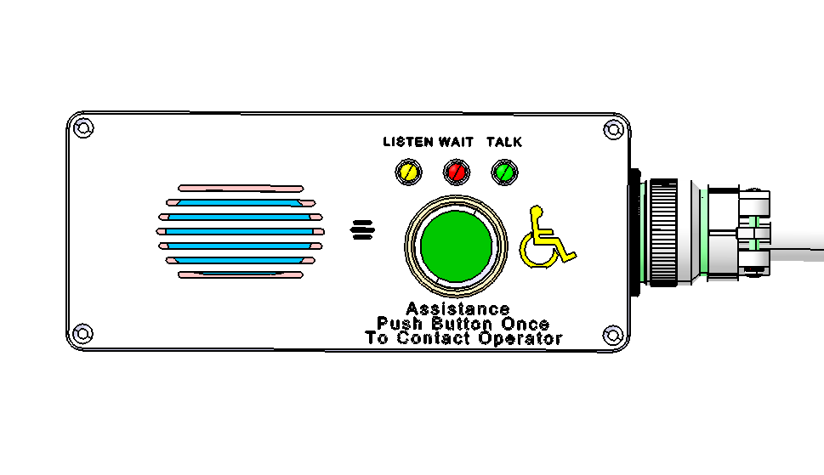
Diagram 4.5.2.3-A(49P)

Slide 14
PA Controller Block Diagram
Audio Amplifier Board
Audio File
Memory
PA
Controller
Interior Speaker
Channel 1
Audio File CNCS
(via USB)
Automatic
Broadcasting
Player
Power AMP
Channel 1
Matching
Transformer
Recording
Control
Interior SPK
Volume Control
(Interior Channels)
RS-485 CL
Power AMP
Channel 2
Interior Speaker
Channel 2
Matching
Transformer
Cab On
Exterior SPK
Volume Control
(Left Channel)
Door
I 2C
Conductor Audio
Exterior SPK
Volume Control
(Right Channel)
Power AMP
Channel 3
Exterior Speaker
Channel 1
Left Side
Intercom Audio
Matching
Transformer
Driver Audio
ANS Controller
MCU
Ether net
Ether net VoIP
Control UNIT
I²C (Inter-Integrated Circuit)
Power AMP
Channel 4
Exterior Speaker
Channel 2
Right Side
Line Control
Matching
Transformer
TRF
TRF
Power
Module
PA audio TL
Intercom TL
Ether net
TL
ANS
Microphone
ANS
Microphone
DC37.5V
Trainlines
PA Controller Block Diagram-R01 - 20110228.ppt

Slide 15
Diagram 4.5.2.5-B(54P)
Denver DPO Block Diagram
Volume Control Knob
AMP
AUDIO EXPANDER
Solid State Switching Circuitry
L.P.F
ALC
Transformer
DPO Audio
L.P.F
ALC
Transformer
CPO Audio
AMP
AUDIO COMPANDOR
L.P.F
ALC
Transformer
PEI Audio
Internal
Microphone
L.P.F
ALC
Transformer
VOIP Audio
Lapel Mic. Jack
CAB ON
Communication
BUZZER
& Circuitry
Tone
DRIVER
Dual Tone Audio
Audio Controller
Transformer
Push Button
BUZZER
Logic
Controller
Tone
Filter
Tone
Generator
DC37.5V
Push Button
SPEAKER
Digital
Detection
Digital
Control
INT
EXT
BOTH
Live Signal
Address Signal
To PAC
INTERCOM
Regulator
IC
PEI
CANCEL
DC37.5V
Power
Module
(DPO) Block Diagram-R01 - 20110316.ppt

Slide 16
Diagram 4.5.3.2-B(59P)
Station Trigger Points map
Approaching Station
1001
1002
1003
Platform Station
R
R
1004
A
A
Center Point
Of Station
1005
Station
Station 001
A
TP1 | 1001 | Outer Relative
TP2 | 1002 | Inner Relative
TP3 | 1003 | Approaching Station
TP4 | 1004 | Platform Perimeter
TP5 | 1005 | Center of Station
TP6 | 1006 | Platform Perimeter
TP7 | 1007 | Approaching Station
TP8 | 1008 | Inner Relative
TP9 | 1009 | Outer Relative
A
A
R
R
1006
Platform perimeter
1007
1008
1009
Approaching Station
A
Absolute Trigger Point
R
Relative Trigger Point

Slide 17
Diagram 4.5.4.3-A(61P)
Automatic
Broadcasting
Player
PA
Controller
Interior Speaker
Channel 1
Power AMP
Channel 1
Matching
Transformer
Relay 1
Relay 2
Interior SPK
Volume
Control
Relay 3
Power AMP
Channel 2
Interior Speaker
Channel 2
Relay 4
Matching
Transformer
Relay 5
Relay 6
+12V
-12V
2
Power
Module
I C
Low Pass Filter
37.5V
A/D
Converter
LPF
ANS
Microphone
ANS
Microphone

Slide 18
PAC TL & RS-485 Block Diagram
CRA
PAC
RT
R
e
p
e
a
t
R1
Ra
Rb
RT
RS-485 Train Line Circuitry Block Diagram - 20110331.ppt

Slide 19
Diagram 5.1.5.12-B(117P)
Married Pair
Married A Car
Married B Car
CRA
CRB
PAC
PAC
Rt
Repeat
Rt
Ra
Rt
Repeat
Rt
R
1
Ra
Rb
R
1
Rb
RS
-
485
N
.
O
N
.
C
N
.
C
N
.
O
N
.
O
N
.
C
N
.
C
N
.
O
Relay for train consist
Relay for train consist
N
.
C
N
.
C

Slide 20
Ether net VoIP Block Diagram
FLASH
SPI
Recording
AUDIO
To Recording
DSP
BMP
RX AMP
TO RX AUDIO
TO MCU I/O
GPIO
TX AMP
TO TX AUDIO
TO RS-485 Car Line
UART
RMII
SDI
LDO
LDO
Ethernet
SDRAM
Regulator
12V
RJ45
Mac
Ether net VoIP Control Block Diagram-R01 - 20110228.ppt

Slide 21
ANTENNA
TRIC
Screen Data
CCP
CRA/
CRB
Station Code Data
FDI
SDI
PII
PID1
PID2
INTERNAL/EXTERNAL SPEAKERS
Video Data
Voice Data
DPO
CPO
PEI

Slide 22
DENVER
Wimax Network
Voice Gateways
(VOIP
Dispatcher
VIOP
Application Server for.
Text Messaging
Control Center PA
Public Address Audio
Comm
Rack
TEXT DATA
Ethernet
LED / LCD
DENVER RTD

Slide 23
Communication Rack-A
Communication Rack-A
DC 12V
PSA
DC 37.5V
Wimx
PA System MA
DC 12V
PSA
DC 37.5V
Wimx
PA System MB
SCB
SCB
LIC
LONWORKS for MDS
A
LIC
LONWORKS for MDS
A
WLR
A
WLR
A
LAN
VTX
Digital Video Signal
LAN
VTX
Digital Video Signal
LVDS
Digital Video Signal
LVDS
Digital Video Signal
CNCS
CNCS
ATA
ATA
HDD
CAB ON
HDD
CAB ON
PAC
Door & F/R
PAC
Door & F/R
ODMETER
DC 37.5V
DC 37.5V
ODMETER
DC 37.5V
DC 37.5V
485
Card
RS485
Passenger Emergency
Intercom
Passenger Emergency
Intercom
485
Card
RS485
Passenger Emergency
Intercom
Passenger Emergency
Intercom
DC 12V
DC 12V
BACK PLAN BOARD
RS485
ANSM
PEI ADDRESS, CALL
ANSM
BACK PLAN BOARD
RS485
ANSM
PEI ADDRESS, CALL
ANSM
VOIP
PEI ADDRESS, CALL
PEI Audio & Signal
PEI ADDRESS, CALL
VOIP
PEI ADDRESS, CALL
PEI Audio & Signal
PEI ADDRESS, CALL
PEI Audio & Signal
PEI Audio & Signal
PEI Audio & Signal
PEI Audio & Signal
Dual - tone
Dual - tone
Dual - tone
Dual - tone
DPO ADDRESS, ACT
DPO ADDRESS, ACT
DPO ADDRESS, ACT
DPO ADDRESS, ACT
PA Audio & Signal
PA Audio & Signal
PA Audio & Signal
PA Audio & Signal
DC 37.5V
DC 12V
Driver PA
HandSet
DC 37.5V
DC 12V
Driver PA
HandSet
DPH
Audio
Driver PA
Operation Box
DIMMER
Audio
Audio
DPH
Audio
Driver PA
Operation Box
DIMMER
Audio
Audio
IC Audio & Signal, PA Audio
Audio
Driver Microphone
IC Audio & Signal, PA Audio
IC Audio & Signal, PA Audio
Audio
Driver Microphone
IC Audio & Signal, PA Audio
CPO ADDRESS, ACT
IC Audio & Signal, PA Audio
CPO ADDRESS, ACT
CPO ADDRESS, ACT
IC Audio & Signal, PA Audio
CPO ADDRESS, ACT
CPO ADDRESS, ACT
PEI TL
CPO ADDRESS, ACT
PEI TL
IC TL
IC TL
MUTE
MUTE
DC 37.5V
Passenger
Emergency
Intercom
ISP
ISP
Passenger
Emergency
Intercom
DC 37.5V
PA Audio TL
DC 37.5V
Passenger
Emergency
Intercom
ISP
ISP
Passenger
Emergency
Intercom
DC 37.5V
PA Audio TL
TRF
TRF
Dual- tone TL
TRF
TRF
Dual- tone TL
RS485 TL
RS485 TL
TRF
ISP
TRF
ISP
TRF
ISP
TRF
ISP
TRF
ISP
TRF
ISP
TRF
ISP
TRF
ISP
TRF
ISP
TRF
ISP
TRF
ISP
TRF
ISP
AAB
Interior Speaker CH1
Interior Speaker CH1
AAB
Interior Speaker CH1
Interior Speaker CH1
Audio LINE
Interior Speaker CH2
Interior Speaker CH2
Audio LINE
Interior Speaker CH2
Interior Speaker CH2
DC 37.5V
LEFT Side Exterior Speaker PA
DC 37.5V
LEFT Side Exterior Speaker PA
TRF
ESP
TRF
ESP
TRF
ESP
TRF
ESP
TRF
ESP
TRF
ESP
TRF
ESP
TRF
ESP
RIGHT Side Exterior Speaker PA
RIGHT Side Exterior Speaker PA
RS485 TL
RS485 TL
RS485 TL
RS485 TL
Dual- tone TL
Dual- tone TL
Dual- tone TL
Dual- tone TL
PA Audio TL
PA Audio TL
PA Audio TL
PA Audio TL
IC TL
IC TL
IC TL
IC TL
PEI TL
PEI TL
PEI TL
PEI TL

Slide 24
RS 485 Train Line Relay States During Inauguration
Inauguration Steps Input Signal |  | Married A 1nd |  | Married B 2nd |  |  | Married A 3nd |  | Married B 4nd |  |  | Married A 5nd |  | Married B 6nd |  |  | Married A 7nd |  | Married B 8nd
 |  | PAC A | PAC B | PAC A | PAC B |  | PAC A | PAC B | PAC A | PAC B |  | PAC A | PAC B | PAC A | PAC B |  | PAC A | PAC B | PAC A | PAC B
 |  | Ra | Rb | Ra | Rb |  | Ra | Rb | Ra | Rb |  | Ra | Rb | Ra | Rb |  | Ra | Rb | Ra | Rb |  |  | 1 | 2 | 3 | 4 | 5 | 6 | 7 | 8
1. Power ON |  | c | c | c | c |  | c | c | c | c |  | c | c | c | c |  | c | c | c | c |  |  | X | X | X | X | X | X | X | X
 |  |  |  |  |  |  |  |  |  |  |  |  |  |  |  |  |  |  |  |  |  | All Relays default to the close (on) State
2. Coupler Check |  | c | c | c | c |  | c | c | c | c |  | c | c | c | c |  | c | c | c | c |  |  | X | X | X | X | X | X | X | X
 |  |  |  |  |  |  |  |  |  |  |  |  |  |  |  |  |  |  |  |  |  | PAC - A of the 1st Car & PAC-B of 8th Car both hold a TOC token
3. Cab-ON @(2nd, PAC-A) SET Master PAC |  | O | c | c | c |  | c | c | c | c |  | c | c | c | c |  | c | c | c | O |  |  | X | X | X | X | X | X | X | X
 |  |  |  |  |  |  |  |  |  |  |  |  |  |  |  |  |  |  |  |  |  | PAC-A of the 2nd Car is the Master PAC.
4. Request TOC Response |  | O | c | c | c |  | c | O | c | c |  | c | c | c | c |  | c | c | c | O |  |  | 1 | X | X | X | X | X | X | X
 |  |  |  |  |  |  |  |  |  |  |  |  |  |  |  |  |  |  |  |  |  | Open(2nd,PAC-A,Rb)to disconnect from Paired PAC-B, Master PAC requests Toc response & (1st. PAC - A) responds.
5. Set HOC Token Flag |  | O | c | c | c |  | c | c | c | c |  | c | c | c | c |  | c | c | c | O |  |  | 1 | X | X | X | X | X | X | X
 |  |  |  |  |  |  |  |  |  |  |  |  |  |  |  |  |  |  |  |  |  | Master PAC sets (1st. PAC - A) HOC & then returns all relays to default status.
6. Request TOC Response |  | O | c | c | c |  | c | c | c | c |  | c | c | c | c |  | c | c | c | O |  |  | 1 | X | X | X | X | X | X | 8
 |  |  |  |  |  |  |  |  |  |  |  |  |  |  |  |  |  |  |  |  |  | The only remaining remaining TOC token is held by (8th, PAC-B) & responds to the request
7. Get Response & Update Consist Inauguration Tables |  | O | c | c | c |  | c | c | c | c |  | c | c | c | c |  | c | c | c | O |  |  | 1 | X | X | X | X | X | X | 8
 |  |  |  |  |  |  |  |  |  |  |  |  |  |  |  |  |  |  |  |  |  | All PAC's update their Inauguration table with HOC, TOC, and Master Info.
8. Pass Token (1ST. PAC-B) |  | O | c | C | O |  | O | c | c | O |  | O | c | c | O |  | O | c | c | O |  |  | 1 | X | X | X | X | X | X | 8
 |  |  |  |  |  |  |  |  |  |  |  |  |  |  |  |  |  |  |  |  |  | The PAS Token is passed from the HOC token holder to the next adjacent PAC.
9. Get Response & Update Consist Inauguration Tables |  | O | c | C | C |  | c | c | c | c |  | c | c | c | c |  | c | c | c | O |  |  | 1 | 2 | X | X | X | X | X | 8
 |  |  |  |  |  |  |  |  |  |  |  |  |  |  |  |  |  |  |  |  |  | All PAC's update their Inauguration table to include (2st. PAC-B) paramaters.
10. Pass Token (2nd, PAC-A) |  | O | c | c | c |  | C | O | O | c |  | c | O | O | c |  | c | O | c | O |  |  | 1 | 2 | X | X | X | X | X | 8
 |  |  |  |  |  |  |  |  |  |  |  |  |  |  |  |  |  |  |  |  |  | The PAS token is passed from the current token holder to the next adjacent PAC.
11. Get Response & Update Consist Inauguration Tables |  | O | c | c | c |  | C | C | c | c |  | c | c | c | c |  | c | c | c | O |  |  | 1 | 2 | 3 | X | X | X | X | 8
 |  |  |  |  |  |  |  |  |  |  |  |  |  |  |  |  |  |  |  |  |  | All PAC's update their Inauguration table to include (3st. PAC-B) paramaters.
12. Pass Token (2nd, PAC-A) |  | O | c | c | c |  | c | c | C | O |  | O | c | c | O |  | O | c | c | O |  |  | 1 | 2 | 3 | X | X | X | X | 8
 |  |  |  |  |  |  |  |  |  |  |  |  |  |  |  |  |  |  |  |  |  | The PAS token is passed from the current token holder to the next adjacent PAC.
13. Get Response & Update Consist Inauguration Tables |  | O | c | c | c |  | c | c | C | C |  | c | c | c | c |  | c | c | c | O |  |  | 1 | 2 | 3 | 4 | X | X | X | 8
 |  |  |  |  |  |  |  |  |  |  |  |  |  |  |  |  |  |  |  |  |  | All PAC's update their Inauguration table to include (4st. PAC-B) paramaters.
14. Pass Token (2nd, PAC-A) |  | O | c | c | c |  | c | c | c | c |  | C | O | O | c |  | c | O | c | O |  |  | 1 | 2 | 3 | 4 | X | X | X | 8
 |  |  |  |  |  |  |  |  |  |  |  |  |  |  |  |  |  |  |  |  |  | The PAS token is passed from the current token holder to the next adjacent PAC.
15. Get Response & Update Consist Inauguration Tables |  | O | c | c | c |  | c | c | c | c |  | C | C | c | c |  | c | c | c | O |  |  | 1 | 2 | 3 | 4 | 5 | X | X | 8
 |  |  |  |  |  |  |  |  |  |  |  |  |  |  |  |  |  |  |  |  |  | All PAC's update their Inauguration table to include (5st. PAC-B) paramaters.
16. Pass Token (2nd, PAC-A) |  | O | c | c | c |  | c | c | c | c |  | c | c | C | O |  | O | c | c | O |  |  | 1 | 2 | 3 | 4 | 5 | X | X | 8
 |  |  |  |  |  |  |  |  |  |  |  |  |  |  |  |  |  |  |  |  |  | The PAS token is passed from the current token holder to the next adjacent PAC.
17. Get Response & Update Consist Inauguration Tables |  | O | c | c | c |  | c | c | c | c |  | c | c | C | C |  | c | c | c | O |  |  | 1 | 2 | 3 | 4 | 5 | 6 | X | 8
 |  |  |  |  |  |  |  |  |  |  |  |  |  |  |  |  |  |  |  |  |  | All PAC's update their Inauguration table to include (6st. PAC-B) paramaters.
18. Pass Token (2nd, PAC-A) |  | O | c | c | c |  | c | c | c | c |  | c | c | c | c |  | C | O | c | O |  |  | 1 | 2 | 3 | 4 | 5 | 6 | X | 8
 |  |  |  |  |  |  |  |  |  |  |  |  |  |  |  |  |  |  |  |  |  | The PAS token is passed from the current token holder to the next adjacent PAC.
19. Get Response & Update Consist Inauguration Tables |  | O | c | c | c |  | c | c | c | c |  | c | c | c | c |  | C | C | c | O |  |  | 1 | 2 | 3 | 4 | 5 | 6 | 7 | 8
 |  |  |  |  |  |  |  |  |  |  |  |  |  |  |  |  |  |  |  |  |  | All PAC's update their Inauguration table to include (8st. PAC-B) paramaters. Inauguration Complete.
 |  |  |  | TOC Token Flag |  |  |  |  |  |  |  | Master PAC |  |  |  |  | C = Closed
 |  |  |  | HOC Token Flag |  |  |  |  |  |  |  | Update Consist Table |  |  |  |  | O = Open
 |  |  |  | Passing Token |  |  |  |  |  |  |  | Temp TOC Token

Slide 25
RS 485 Train Line Relay States During Inauguration
Inauguration Steps Input Signal |  | Married A 1nd |  | Married B 2nd |  |  | Married A 3nd |  | Married B 4nd
 |  | PAC A | PAC B | PAC A | PAC B |  | PAC A | PAC B | PAC A | PAC B
 |  | Ra | Rb | Ra | Rb |  | Ra | Rb | Ra | Rb |  |  | 1 | 2 | 3 | 4
1. Power ON |  | c | c | c | c |  | c | c | c | c |  |  | X | X | X | X
 |  |  |  |  |  |  |  |  |  |  |  | All Relays default to the close (on) State
2. Coupler Check |  | c | c | c | c |  | c | c | c | c |  |  | X | X | X | X
 |  |  |  |  |  |  |  |  |  |  |  | PAC - A of the 1st Car & PAC-B of 8th Car both hold a TOC token
3. Cab-ON @(2nd, PAC-A) SET Master PAC |  | O | c | c | c |  | c | c | c | c |  |  | X | X | X | X
 |  |  |  |  |  |  |  |  |  |  |  | PAC-A of the 2nd Car is the Master PAC.
4. Request TOC Response |  | O | c | c | c |  | c | O | c | c |  |  | 1 | X | X | 4
 |  |  |  |  |  |  |  |  |  |  |  | Open(2nd,PAC-A,Rb)to disconnect from Paired PAC-B, Master PAC requests Toc response & (1st. PAC - A) responds.
5. Set HOC Token Flag |  | O | c | c | c |  | c | c | c | c |  |  | 1 | X | X | 4
 |  |  |  |  |  |  |  |  |  |  |  | Master PAC sets (1st. PAC - A) HOC & then returns all relays to default status.
6. Request TOC Response |  | O | c | c | c |  | c | c | c | c |  |  | 1 | X | X | 4
 |  |  |  |  |  |  |  |  |  |  |  | The only remaining remaining TOC token is held by (4th, PAC-B) & responds to the request
7. Get Response & Update Consist Inauguration Tables |  | O | c | c | c |  | c | c | c | c |  |  | 1 | X | X | 4
 |  |  |  |  |  |  |  |  |  |  |  | All PAC's update their Inauguration table with HOC, TOC, and Master Info.
8. Pass Token (1ST. PAC-B) |  | O | c | C | O |  | O | c | c | O |  |  | 1 | X | X | 4
 |  |  |  |  |  |  |  |  |  |  |  | The PAS Token is passed from the HOC token holder to the next adjacent PAC.
9. Get Response & Update Consist Inauguration Tables |  | O | c | C | C |  | c | c | c | c |  |  | 1 | 2 | X | 4
 |  |  |  |  |  |  |  |  |  |  |  | All PAC's update their Inauguration table to include (2st. PAC-B) paramaters.
10. Pass Token (2nd, PAC-A) |  | O | c | c | c |  | C | O | O | c |  |  | 1 | 2 | X | 4
 |  |  |  |  |  |  |  |  |  |  |  | The PAS token is passed from the current token holder to the next adjacent PAC.
11. Get Response & Update Consist Inauguration Tables |  | O | c | c | c |  | C | C | c | c |  |  | 1 | 2 | 3 | 4
 |  |  |  |  |  |  |  |  |  |  |  | All PAC's update their Inauguration table to include (3st. PAC-B) paramaters. Inauguration complete.
C = Closed |  |  |  | TOC Token Flag |  |  |  |  |  |  |  | Master PAC
O = Open |  |  |  | HOC Token Flag |  |  |  |  |  |  |  | Update Consist Table
 |  |  |  | Passing Token |  |  |  |  |  |  |  | Temp TOC Token

Slide 26
PTU
Wayside
Speakers
PASSENGER
ODOMETER
CNCS
PID
PII
DOOR
WLAN
FDI
SDI
CAB
VTX
VOIP
PAC
PEI
DPO
REC
LIC
CREW
MDS
CCP
: External Entity & System
: CS Unit
: Process

